Slide 1
Why Brands Work With AKBA LLC
Our biggest differentiator? We buy your inventory and you benefit from our acceleration technology and services at no fee.

Slide 2
We Buy Your Inventory
We Apply Tech & Services
We Identify Acceleration Gaps
On day one of our partnership, we’ll place orders for all of the inventory we’ll sell in the first few months. As we sell it, we’ll keep buying more. Our unique model is designed to accelerate your ecommerce growth as quickly as possible.
Using our data science foundation and technology, we’ll identify your most urgent ecommerce acceleration gaps. Then, together with our marketplace managers, we’ll make a plan to execute strategies that fill the gaps, unleashing your acceleration potential at global scale.
Using our proprietary software and team of marketplace experts Pattern provides growth and control for ecommerce and marketplaces. Finally, you’ll have the bandwidth and the right data to achieve your ecommerce goals.

Slide 3
Your Ecommerce Growth Accelerates
Capitalizing on data insights from our technology, we’ll help you accelerate strategies for revenue growth and brand control. You’ll see continued benefits as your product stays in stock, and our marketing strategies and optimization techniques increase your sales.
We Repeat at Global Scale
Why identify patterns in ecommerce data? To find the winning formula and repeat it across new markets and regions. We’ll work with you to examine global expansion opportunities and the marketplaces we can dominate next.

Slide 4
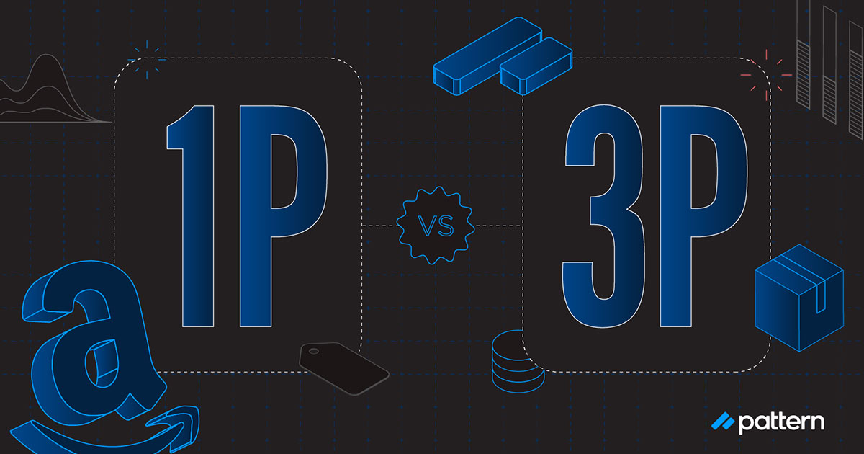
Amazon 1P vs. 3P: Pros & Cons Brands Need to Know
Whether you’ve been selling your products on Amazon for years or you’re just starting out, you’ve probably wondered if 1P or 3P is the best selling model for your brand. As the top ecommerce accelerator and 3P seller with deep experience on Amazon, we know there’s no “best way” to sell on Amazon—it depends on your products, long-term goals, and capabilities.
Learn more about 1P vs 3P below.
What is 1P vs 3P?
1P Pros and Cons
3P Pros and Cons
How Do I Become an Amazon 3P Seller?
3P Partners and Other Selling Model Strategies

Slide 5
What is 1P vs 3P?
In a 1P, or first-party relationship, Amazon buys your product wholesale and handles most of the selling details. In a 3P, or third-party relationship, you’re an independent seller on Amazon’s marketplace, which gives you both more control over your brand and more responsibility for logistics.
Deciding between 1P and 3P requires weighing the various pros and cons for your business. Brands should consider several factors before choosing which strategy makes sense. Here’s more information about the pros and cons of both 1P and 3P so you can make the best decision for your brand.
1P Pros and Cons Pros:
Amazon is a well-trusted brand—consumers may trust your brand more if your products are sold by Amazon.
With 1P, your products are automatically eligible for Amazon Prime and two-day shipping.
Amazon handles all the logistics for 1P selling: taxes, ASIN, optimization, and customer service.
Amazon gives exclusive benefits, such as placement priority and advanced analytics tools, to 1P sellers.
Selling your products through Amazon 1P could be the most price efficient option for your brand.
You’re basically free of inventory risk and possible listing disciplinary measures.

Slide 6
Cons:
In a 1P relationship, Amazon has the control to sell your product at any price they see fit, even if it’s below your established Minimum Advertising Price (MAP).
You may lose profit margins to Amazon with a 1P relationship. (Learn the true costs of Amazon 1P.)
Amazon will pay you less frequently than in a 3P relationship.
You will have little control over availability of inventory on Amazon at any given time.
Amazon can drop you as a 1P seller at any time.
Many brands choose to sell on Amazon in a 1P relationship so they don’t have to manage most of the logistics—they simply prefer Amazon to do it. Another big benefit is having a well-trusted brand selling and somewhat representing your products.
3P Pros and Cons Pros:
Gives you more flexibility and control in every aspect of the selling process.
Strengthens your brand presence.
Helps you gain better access to data.
Provides more control in the selling process (pricing, inventory, and product listings).
Offers complete control over how much inventory to list.
You can share inventory across marketplaces when necessary.
You have creative control to develop listings with better optimized content to tell your brand story.

Slide 7
How Do I Become an Amazon 1P or 3P Seller?
You can only become a 1P seller through a direct invitation from Amazon. To become a 3P seller, the first step is setting up a Seller Central account. You’ll then provide relevant information and verifications before getting your account approved and finally listing and shipping your products.
When it comes to shipping your products as a 3P seller on Amazon, you have two options: Fulfillment by Merchant (FBM) or Fulfillment by Amazon (FBA). If you choose FBM, you are responsible for maintaining inventory, labeling, packaging, and shipping your products to each customer. If you choose FBA, your inventory is stored in Amazon’s fulfillment centers—you don’t need to worry about packaging and shipping. However, if you do choose FBA, you’ll need to meet the prep requirements.
3P Partners and Other Selling Model Strategies
While deciding between a 1P or 3P relationship is a solid start, selling model strategy is a bit more complicated than that. In fact, there are 7 common selling models brands may consider. Two of these models are the basic 1P and 3P models we’ve already discussed.
Other models include the following:
3P Unmanaged: no active management of your brand
2P: Fulfilled by Amazon (FBA) model
Hybrid: leverages both 1P and 3P strategies
3P Network: you create a network of authorized sellers
3P Partner: you partner with one exclusive ecommerce seller

Slide 8
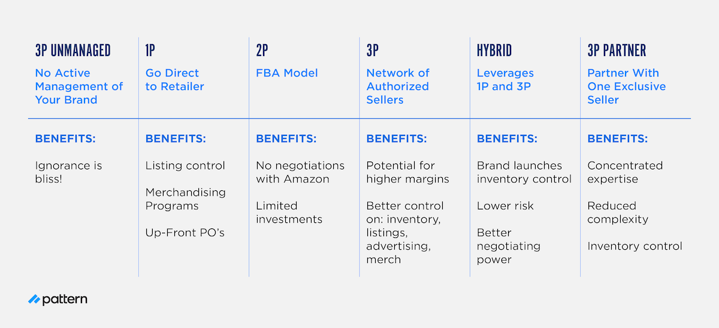

Slide 9
With AKBA LLC as your authorized wholesale partner, we buy your stock and resell the products on Amazon as an authorized seller. Once we buy your product, we’re responsible for all inventory risk and help you optimize your content and advertising while maximizing your brand protection and global strategy development. Our sophisticated inventory forecasting, fulfillment, and logistics systems help us predict and manage your inventory, and our experienced teams handle everything from taxes to customer service.
Unlike a 1P Amazon seller relationship, we’re eager to involve your brand every step of the way, including when it comes to branding, promotion, channel strategy, and new product launches. We respect your brand by following all brand pricing guidelines and committing to never drop below MAP policies.
Interested in increasing your margins by transitioning to a 3P relationship and partnering with AKBA LLC? LETS START TODAY WITH US

Slide 10
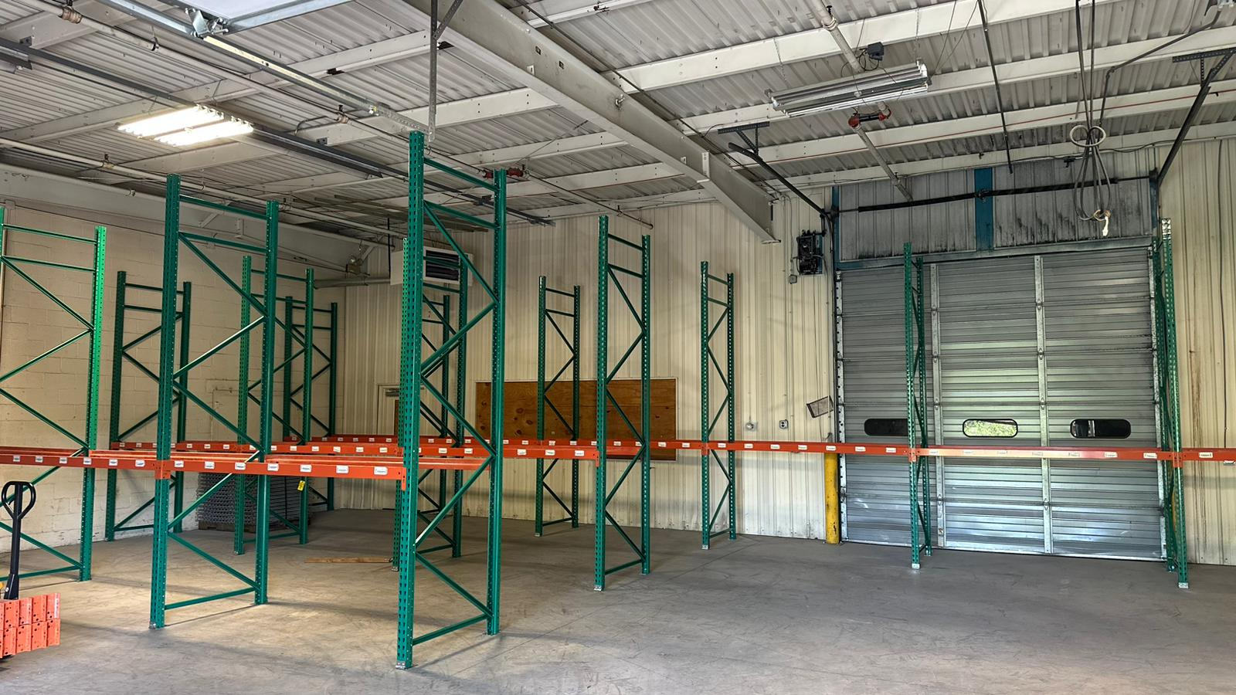
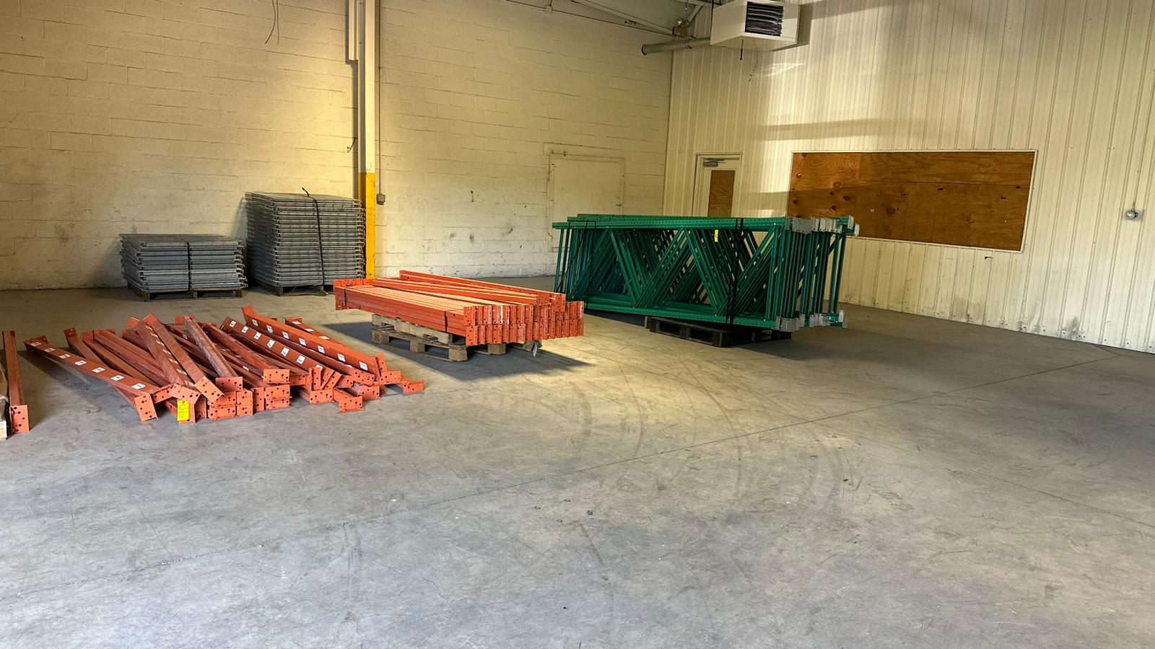
OUR WAREHOUSE FOR STORING THE PRODUCT

Slide 11
OUR TEAM
Our team at AKBA LLC is a dynamic force dedicated to your success. With a passion for Amazon sales optimization and brand growth, we work tirelessly to deliver tailored solutions that drive results. Trust us to protect and propel your business forward in the competitive online marketplace.

